Slide 1


Heart Disease Prediction Using Machine Learning
DONE BY:
PROJECT GUIDE
RA2231241020040
ROSHAN.V.C
III BCA - A
Dr.E.Srimathi

Slide 2

Heart Disease Prediction Using Machine Learning

Slide 3

ABSTRACT
Early detection of heart disease saves lives and improves health. Using a dataset with factors like age, gender, BMI, and cholesterol, we have to test various machine learning models to identify those at risk. The best model will be integrated into a user-friendly Streamlit app, enabling instant risk predictions. This tool supports early diagnosis and better heart health management.

Slide 4

Feasibility Study
1
Objective
2
Scope
To develop a machine learning-based system and Streamlit app for predicting heart disease, enabling real-time, accurate, and cost-effective diagnosis to support early intervention.
The project aims to predict heart disease risk using clinical data and provide real-time results through a user-friendly web app.

Slide 5

Existing System
Existing Diagnosis
Traditional heart disease diagnosis involves clinical exams, medical history, and tests like EKGs and blood work, relying on expert interpretation and taking time.
Limitations of Existing System
Traditional methods are resource-intensive, less accessible, and prone to delays and diagnostic errors due to subjective interpretation.

Slide 6

Drawbacks of Existing System
Limited Accessibility
Time Consuming
High Cost
Not all healthcare settings, especially rural or low-resource areas, have access to necessary diagnostic tools
Traditional diagnostic tests and procedures take significant time, delaying diagnosis and treatment.
Traditional diagnostic methods, including specialized tests and expert consultations, often incur high costs, making them less affordable for many.

Slide 7




Proposed System
Machine Learning Algorithms
Data Collection
The system will gather various data points from patients, including medical history, demographics, lifestyle habits, and lab test results.
We propose using machine learning algorithms to analyze patient data and predict the risk of heart disease.
Predictive Modeling
The machine learning model will identify patterns in the data and generate predictions about the likelihood of developing heart disease.

Slide 8

Benefits of Proposed System
1
Early Detection
Identifies potential heart disease risks early, enabling preventive measures before symptoms arise.
2
Increased Accuracy
AI-powered models learn from vast amounts of data, improving prediction accuracy over time and reducing human error.
3
Comprehensive Insights
Gathers and analyzes a wide range of patient data (e.g., demographics, lifestyle, medical history), providing a holistic view of heart disease risk.

Slide 9




Scope of the Project
1
Data Collection & Preparation
2
Model Training
3
Deployment & Validation
4
User Interface & Interaction Design

Slide 10

Heart Disease Prediction:
Using Machine Learning for Project Outline
The Heart Disease Prediction project uses Streamlit to develop an AI-powered web app that predicts heart disease risk based on factors like age, medical history, and lifestyle. The app offers a user-friendly interface for real-time predictions, providing a scalable and cost-effective solution for early detection and improved patient outcomes.

Slide 11

Preprocessing Data
1
Data Collection
Gather patient data such as medical history, diagnostic test results, and lifestyle factors. This is essential for building a reliable and diverse dataset.
2
Machine Learning Model
Train a machine learning model (e.g., Logistic Regression, Random Forest, or Neural Network) on the collected data to identify patterns and predict heart disease risk accurately.
3
Web Application
Develop a Streamlit-based web app to enable users to input their data and receive real-time predictions with a user-friendly interface.
4
Web Application
Provide early warnings based on predictions, allowing timely intervention and better health management.

Slide 12
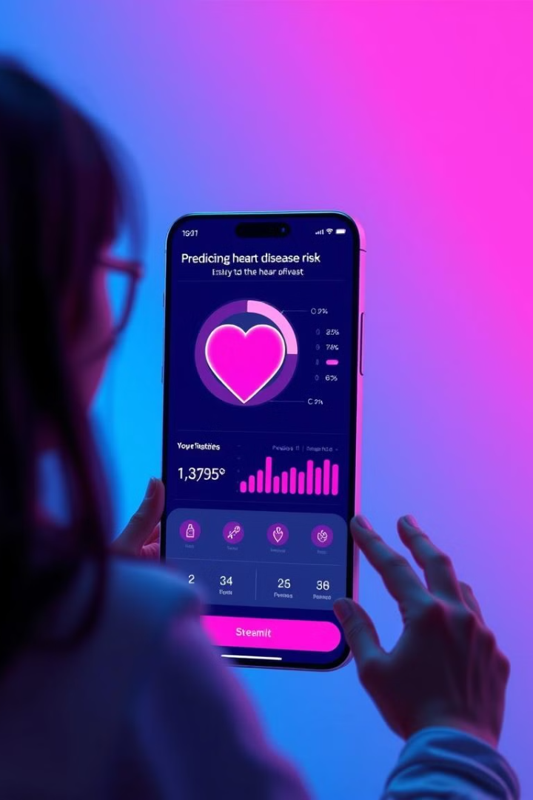



Integrating the Model into a Streamlit Application: Empowering Healthcare
User-Friendly Interface
Improved Risk Assessment
A user-friendly Streamlit application allows healthcare professionals and individuals to easily input patient data, receive risk predictions, and understand the factors contributing to the prediction.
The model provides an objective and data-driven assessment of heart disease risk, aiding clinicians in making informed decisions and recommending preventative measures.
Data-Driven Insights
The application provides valuable insights into the factors influencing heart disease, enabling healthcare professionals to identify trends and develop more effective prevention strategies.

Slide 13



Conclusion: Empowering Early Intervention and Future Directions
Early Intervention
Early Intervention involves detecting health issues early, allowing for timely treatment. In heart disease, it helps prevent or delay serious conditions, improving outcomes and reducing healthcare costs. It empowers individuals to make informed decisions and take proactive steps for better health.
1
Improved Treatment
2
Improved Treatment involves using early predictions and data-driven insights to tailor personalized healthcare plans.
Cost Reduction
3
Early detection and prevention can potentially reduce healthcare costs associated with managing heart disease, benefiting both patients and healthcare systems.

Slide 14

SYSTEM SPECIFICATION
Software Configuration
Operating System: Windows 11
Backend: Python (with libraries like Scikit-learn, Pandas, NumPy), Vs code
Database: MySql
Model Deployment: Streamlit

Slide 15

Hardware Configuration
Processor: Intel Core i5 (or equivalent)
RAM: 8 GB (minimum)
Storage: 500 GB HDD/SSD
Internet: High-speed internet connection for real-time data processing
Operating System: Windows 11

Slide 16


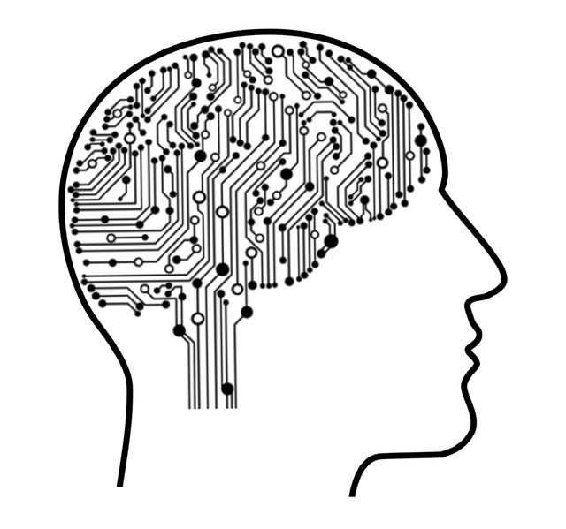
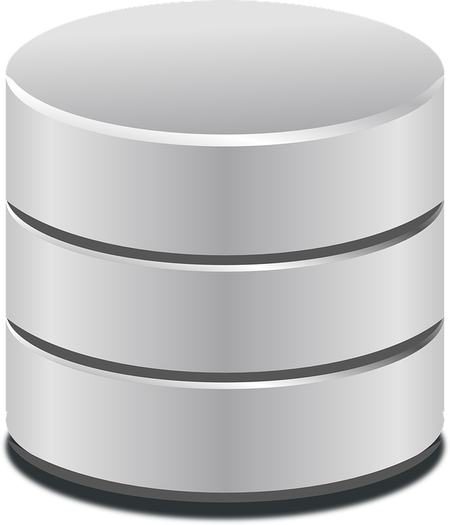
Deployment Environment
PYTHON
MACHINE LEARNING
STREAMLIT
SQL

Slide 17
Project Overview
The Heart Disease Prediction System uses machine learning to detect heart disease based on clinical data like age, BMI, cholesterol, and etc. It follows steps like data processing, model training, and deployment. A Streamlit-based UI allows users to enter data and get instant predictions, helping in early detection and better treatment planning.

Slide 18
Agenda
Defines the architecture, components, and data flow of the Heart Disease Prediction System
Main Components:
Modules Explanation
Data Flow Diagram (DFD)
Architecture Diagram
Database Design
Machine Learning Model

Slide 19
Modules Explanation
User Interface (Frontend - Streamlit)
Collects user input: Age, BMI, Blood Pressure, Cholesterol, etc.
Displays heart disease prediction results (Risk: Present/Absent).
Data Processing Module
Cleans and normalizes data.
Encodes categorical variables.

Slide 20
Modules Explanation
Machine Learning Model (Prediction Engine)
Loads the trained model.
Predicts heart disease risk based on input.
Database Management Module
Stores patient data and clinical records.
Saves and retrieves prediction results.
Model Training & Evaluation Module
Trains ML models using clinical datasets.
Evaluates and selects the best-performing model.

Slide 21
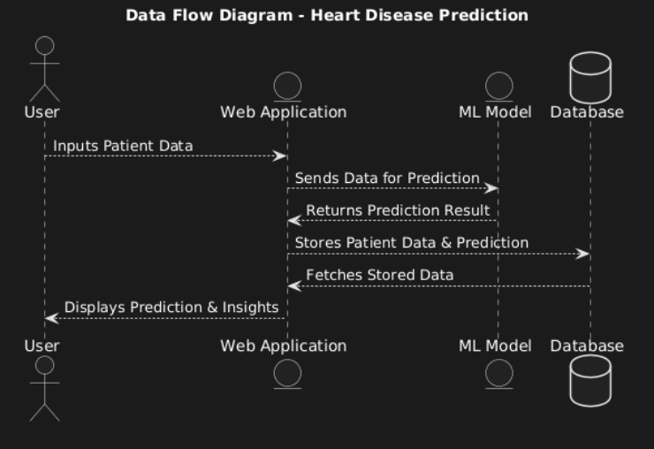
Data Flow Diagram

Slide 22
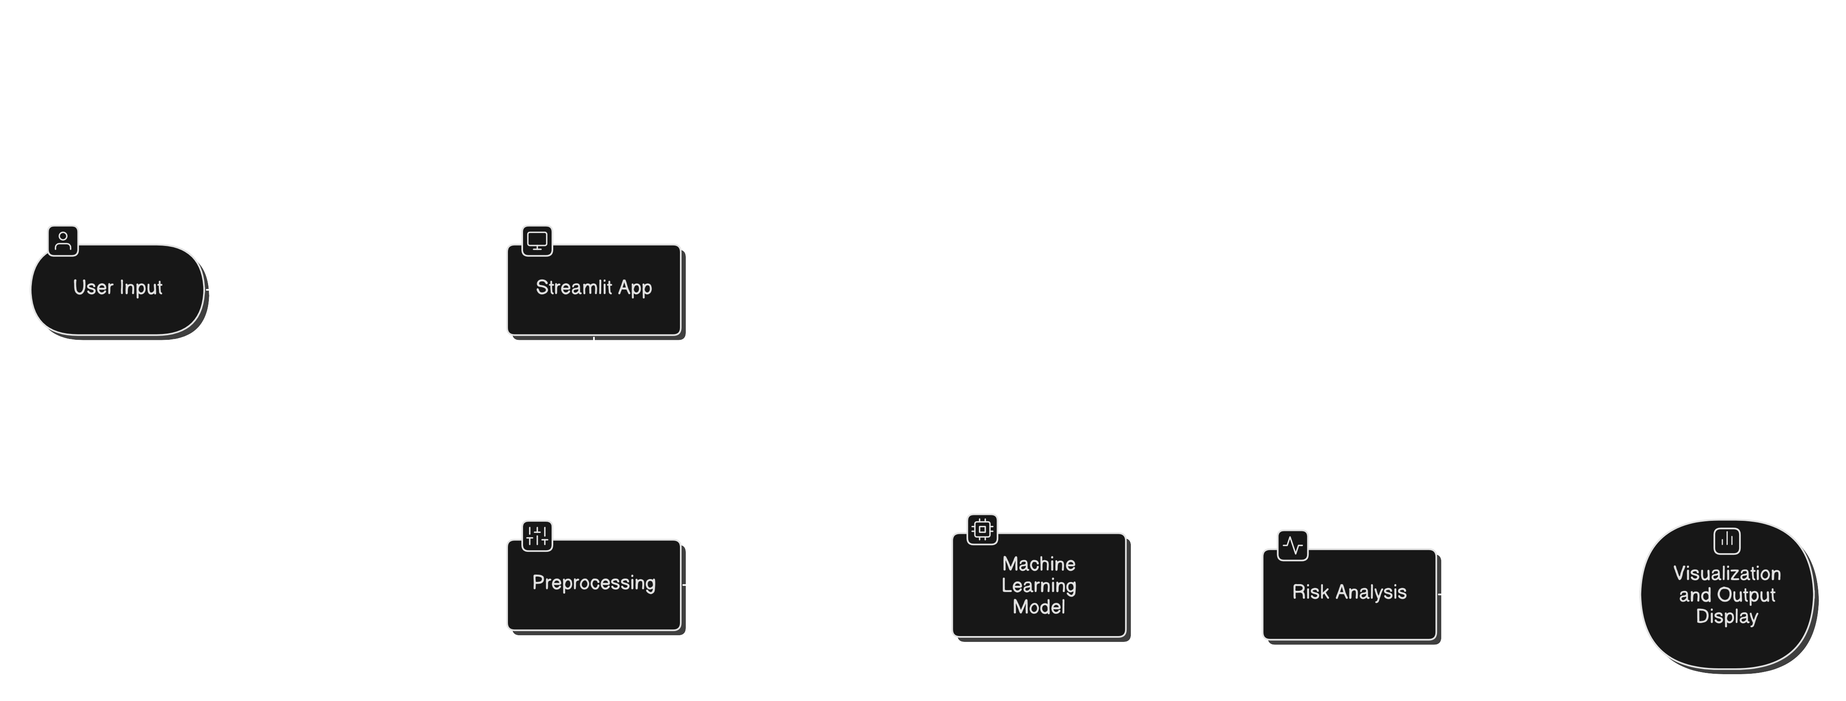
Data Flow Diagram

Slide 23
Data Flow Diagram Explanation
User inputs patient data into the Web Application.
The Web Application sends this data to the ML Model for prediction.
The ML Model processes the data and returns the prediction result.
The prediction and patient data are stored in the Database.
The Web Application can fetch stored data from the Database.
Finally, the Web Application displays the prediction and insights to the User.

Slide 24
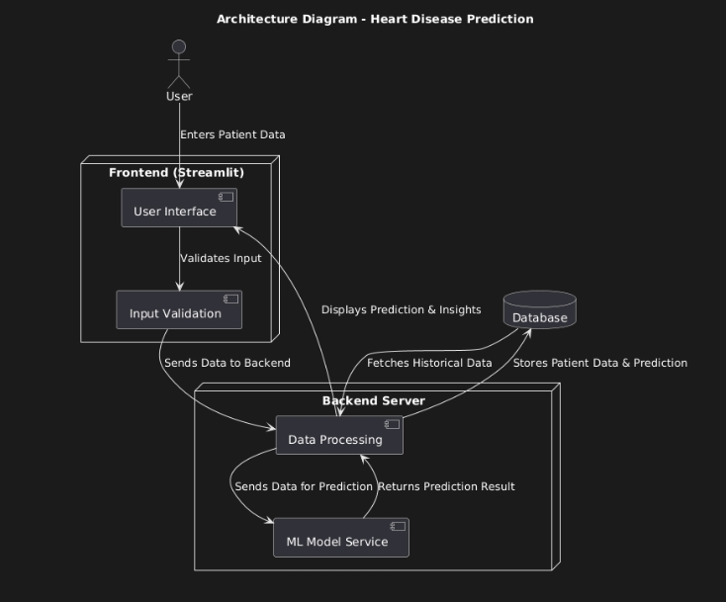
Architecture Diagram

Slide 25
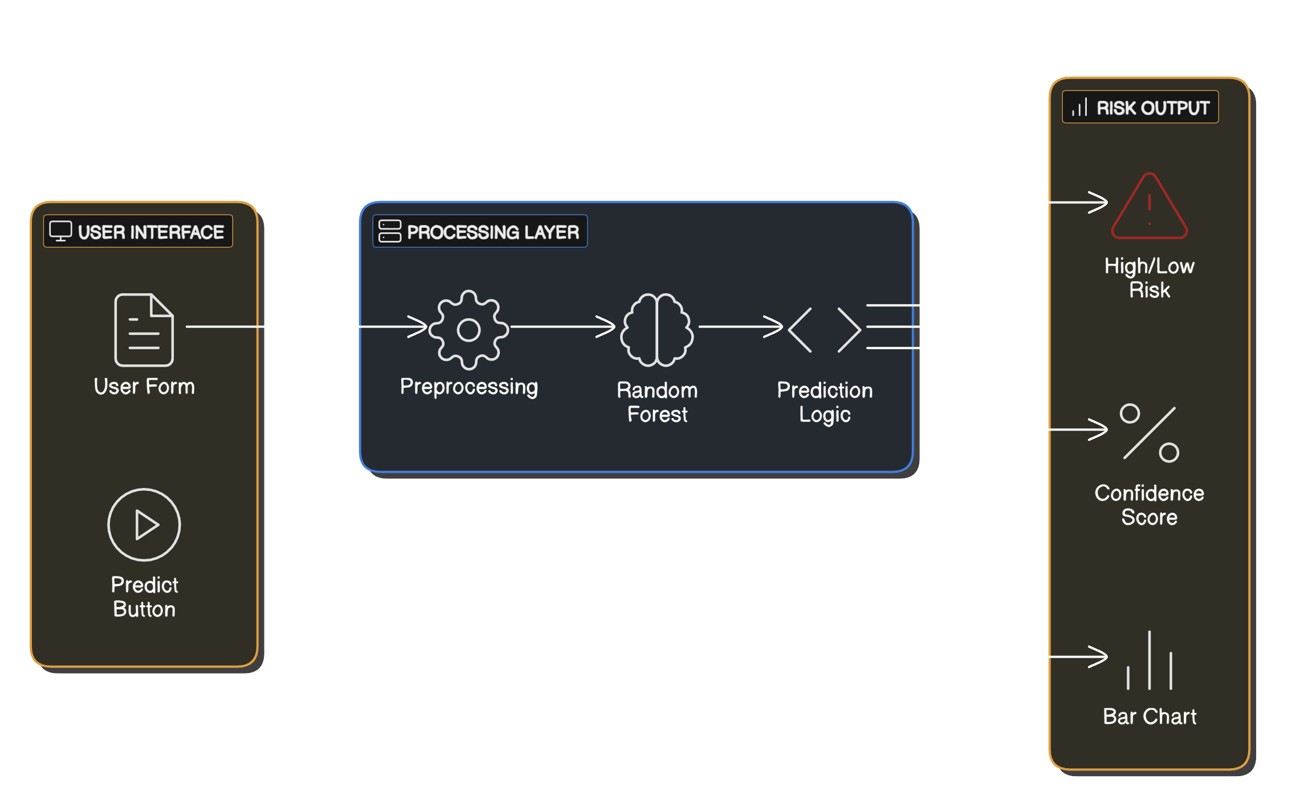
Architecture Diagram

Slide 26
Architecture Diagram Explanation
User enters patient data via the Frontend (Streamlit), which has a User Interface and Input Validation.
The validated data is sent to the Backend Server, where it undergoes Data Processing.
The ML Model Service receives the processed data, makes a prediction, and sends the result back.
Predictions and patient data are stored in the Database.
Historical data can be fetched from the Database for insights.
The Frontend displays predictions and insights to the User.

Slide 27
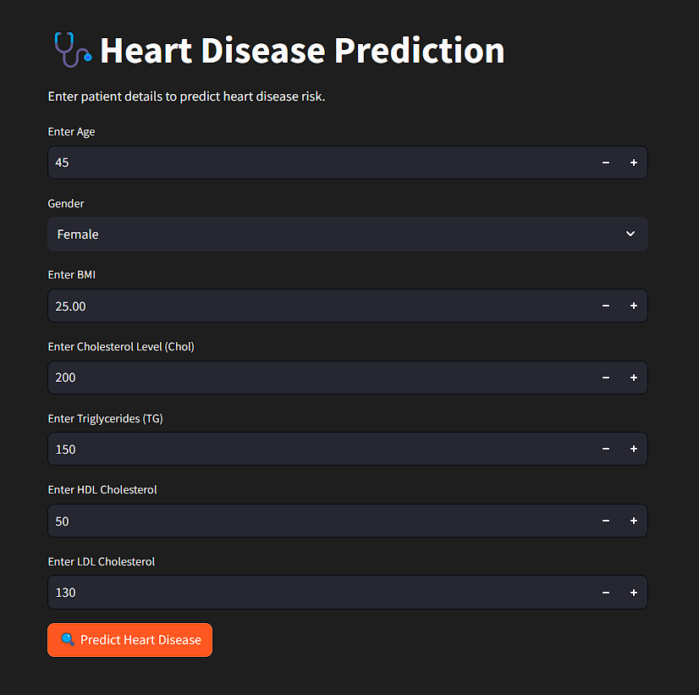
STREAMLIT

Slide 28
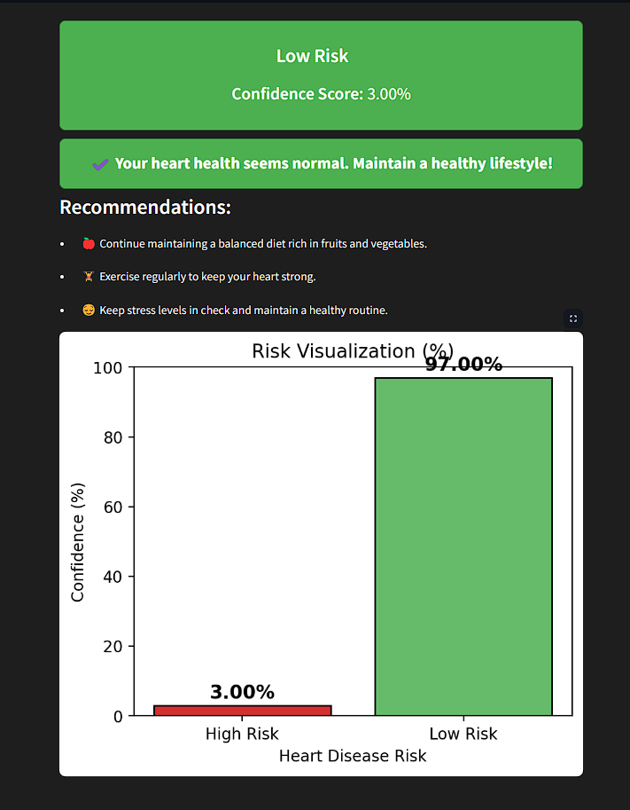
STREAMLIT

Slide 29
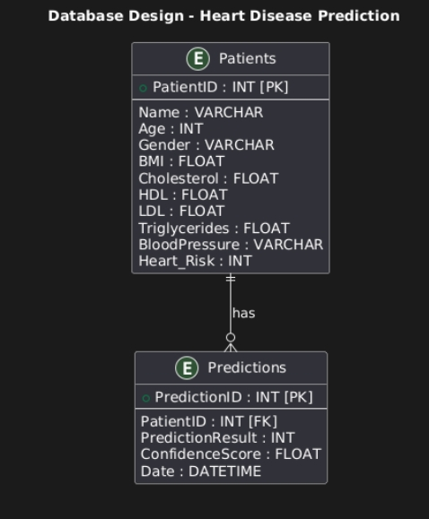
Database Schema Diagram

Slide 30
Database Design
The system uses a relational database to store patient records, clinical data, and predictions.
Key Tables:
Patient Table: Stores basic patient details.
Clinical Data Table: Stores medical parameters for prediction.
Prediction Table: Stores model-generated results.
Ensures efficient data retrieval and storage for accurate predictions.

Slide 31
Database Schema
Patient Table: [ PK – Primary Key
PatientID (PK), Name, Age, Gender, Contact FK – Foreign Key ]
Clinical Data Table:
ClinicalDataID (PK), PatientID (FK), BMI, Cholesterol, HDL, LDL, Triglycerides, Heart_Risk
Prediction Table:
PredictionID (PK), PatientID (FK), ClinicalDataID (FK), PredictionResult, ConfidenceScore, Timestamp

